Slide 1
Data Manipulation in Python and Pandas
Lecture 3

Slide 2
Data Manipulation
Since we are starting out in statistical methods/machine learning, a lot of what we will be doing is manipulating data
We are going to use the pandas dataframe library in python since it's popular and powerful
However, it can be slow. I've heard that polars is faster. I'll let you be the judge there

Slide 3
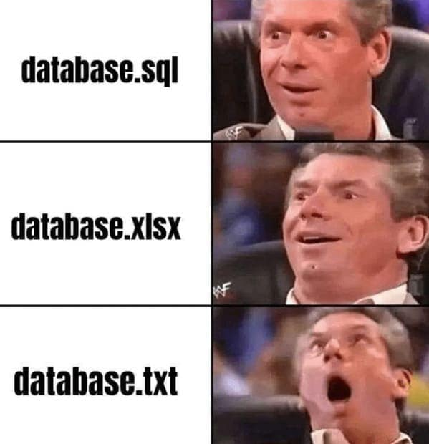
Working with Data
So, this class is based around using AI techniques in a particular application area
So, more than likely you will be using excel files
You might use another database
But you will probably be using excel files
So let's get started learning pandas with a csv
https://thunderdungeon.com/2024/05/01/programmer-memes/

Slide 4
First Code-Along!
Let's get to it.
The Wine Quality dataset can be viewed here: https://archive.ics.uci.edu/dataset/186/wine+quality
And the citation for the dataset is here: P. Cortez, A. Cerdeira, F. Almeida, T. Matos and J. Reis.Modeling wine preferences by data mining from physicochemical properties.In Decision Support Systems, Elsevier, 47(4):547-553. ISSN: 0167-9236.
This 2009 dataset has 13 variables, one of which is a wine quality score (quality) between 0 and 10. We will use the winequality-white csv (comma separated value, a pretty common form for datasets) dataset, which has 4898 rows. A more complete description of the data can be found in the documentation for the dataset, especially the winequality.names file.

